Slide 1





Research titled:
Organizational Restructuring Strategy

Slide 2
Research titled:
Organizational Restructuring Strategy

Slide 3


Chapter Two: A Case Study on Organizational Restructuring Strategy
The analysis was conducted using a 2020 Kaggle dataset called “Human Resources Data Set,” with 36 columns and 311 rows.
The database was created by Drs. Carla Patalano and Rich Huebner , and is used to train MBA students at the New England College of Business. In MSHRM

Slide 4
Chapter Two: A Case Study on Organizational Restructuring Strategy
Main variables in the data:
Demographic information: name, date of birth, age, gender, marital status.
Employment Information: Date of Hire, Department, Employment Status (Active or Separated), Job Title, Pay Rate.
Additional information:
Reasons for termination of service.
Performance scores.
Absence
Date of last performance review.
The degree of employee attachment to the company.

Slide 5

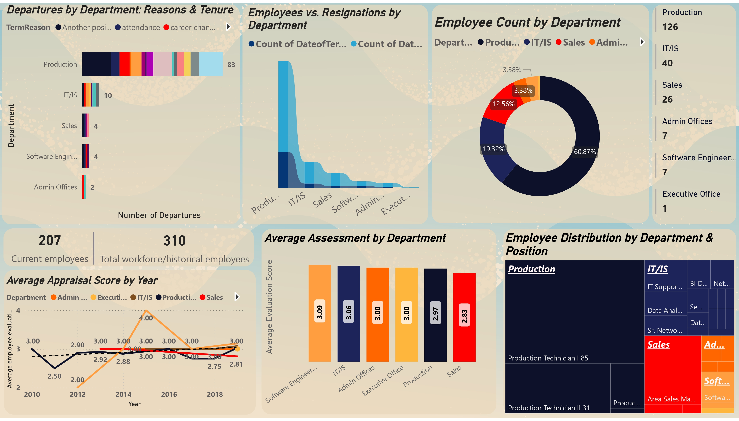
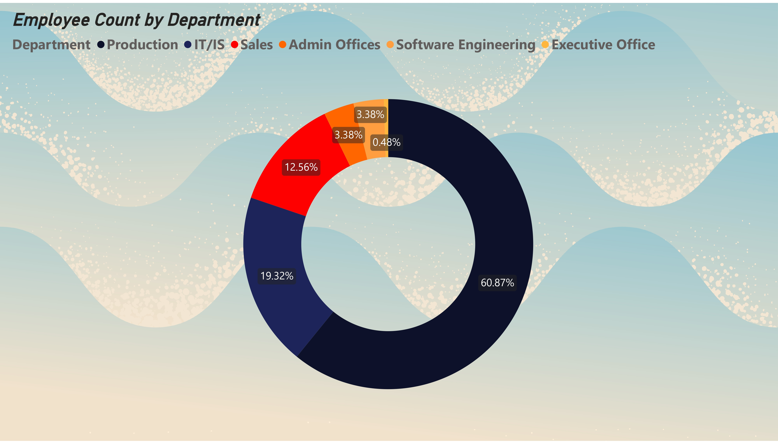
207 Current employees

Slide 6

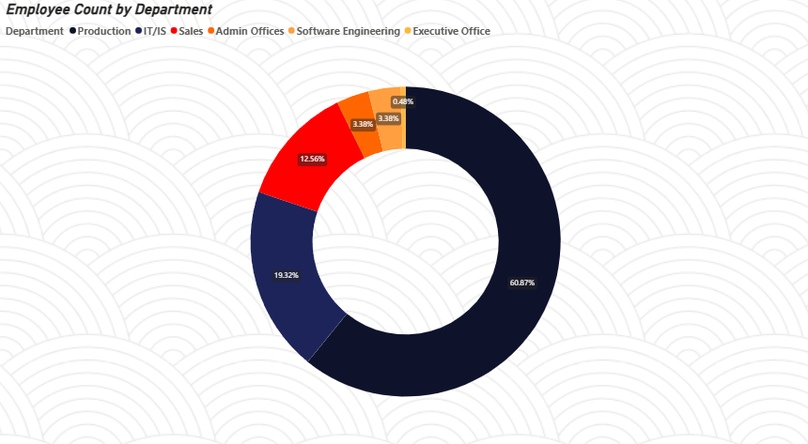
Explanation of the graph and its content
207 Current employees
The pie chart shows the distribution of the institution's workers according to the sector to which they belong.

Slide 7

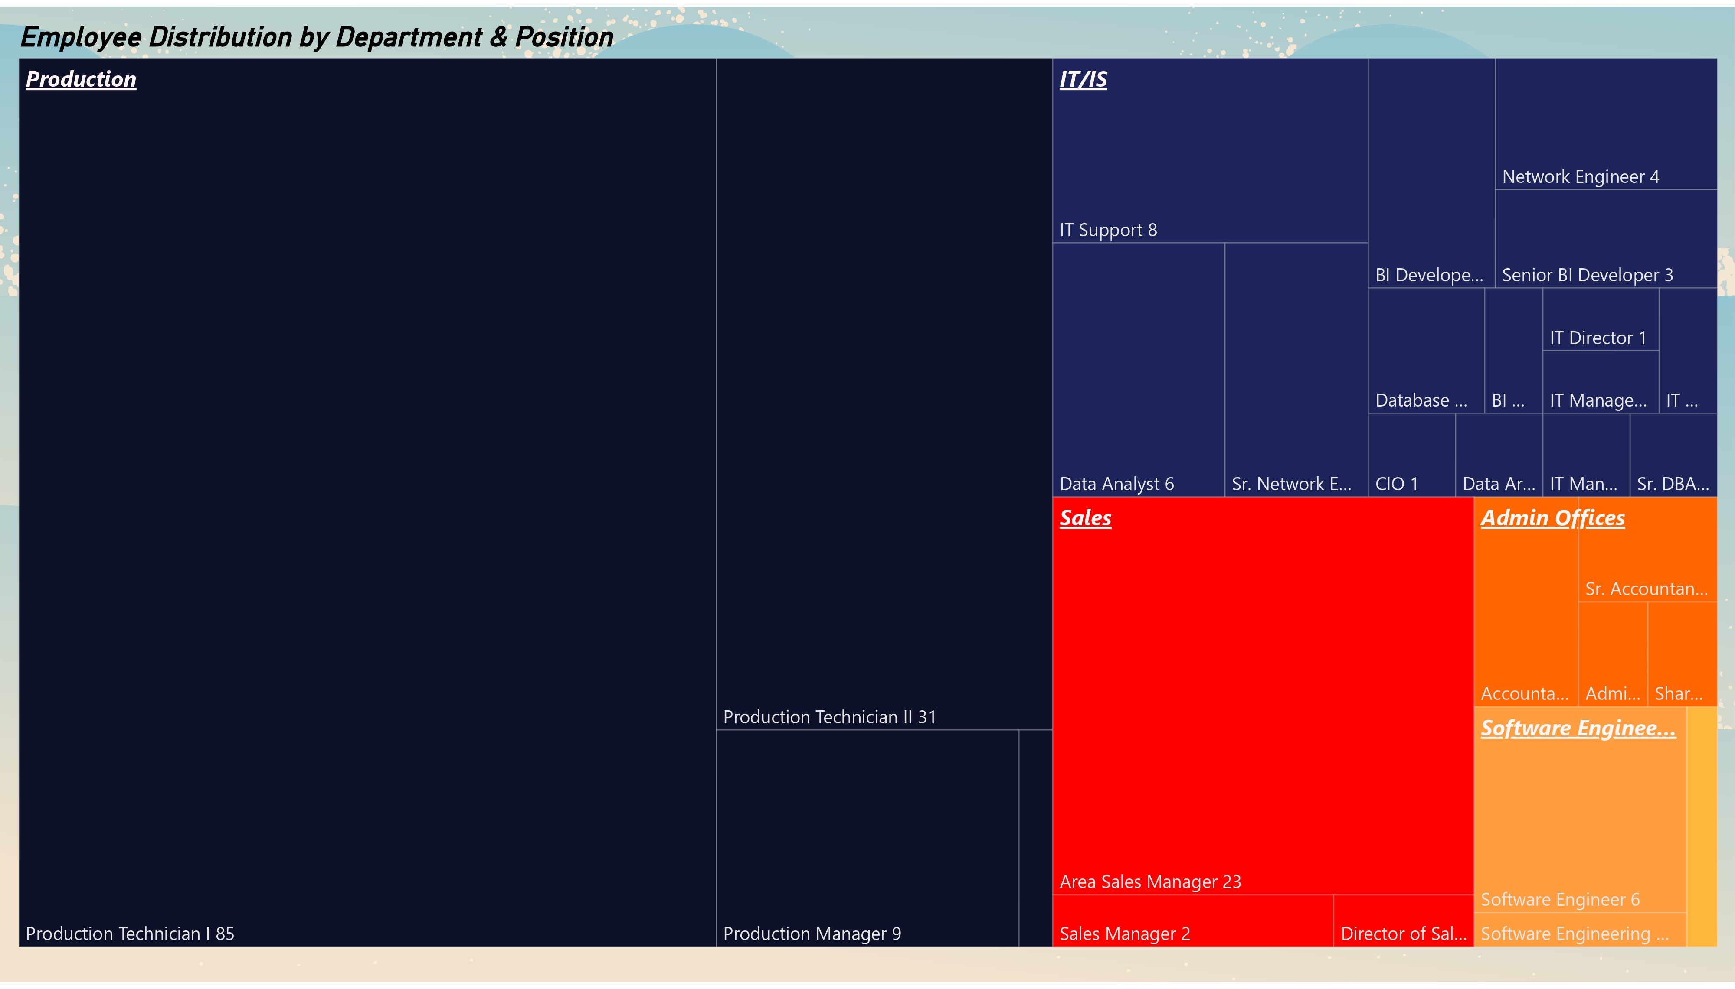
Observations and conclusions
The "production" sector represents the largest share of workers (60.8%), followed by "information technology" (19.3%), while other sectors such as "software engineering" and "management" represent smaller percentages.
-This indicates a great focus on production in the company.
207 Current employees

Slide 8
207 Current employees

Slide 9
207 Current employees

Slide 10
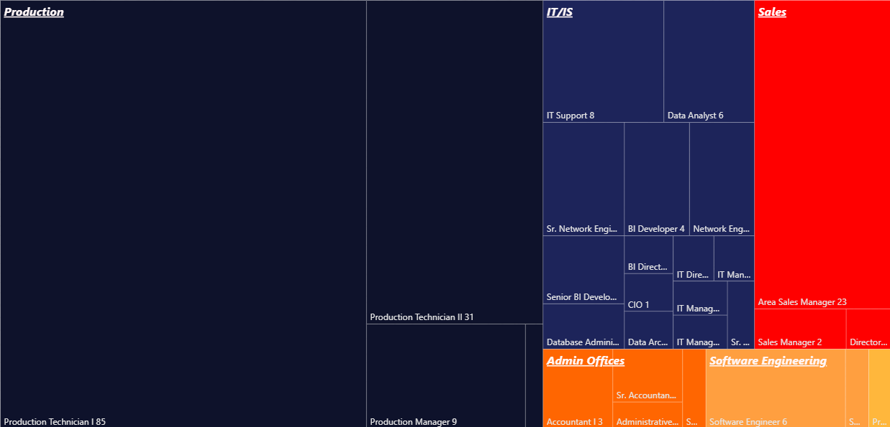
Employee Distribution by Department & Position
Explanation of the graph and its content
Tree map shows Distribution of specializations (works) in each sector with the number of workers in each specialization

Slide 11
Employee Distribution by Department & Position
Observations and conclusions
" Production" sector is characterized by a concentration of workers in technical positions such as "Production Technician I and II", while the "Sales" sector includes administrative roles such as "Area Sales Manager".
This refers to the sectors' focus on specific types of jobs, with the potential to improve job diversity
-It appears that the software engineering department is less complex.
is clear that the Information Technology and Systems Department is equipped with several specializations, as it possesses most of the institution’s specializations.

Slide 12
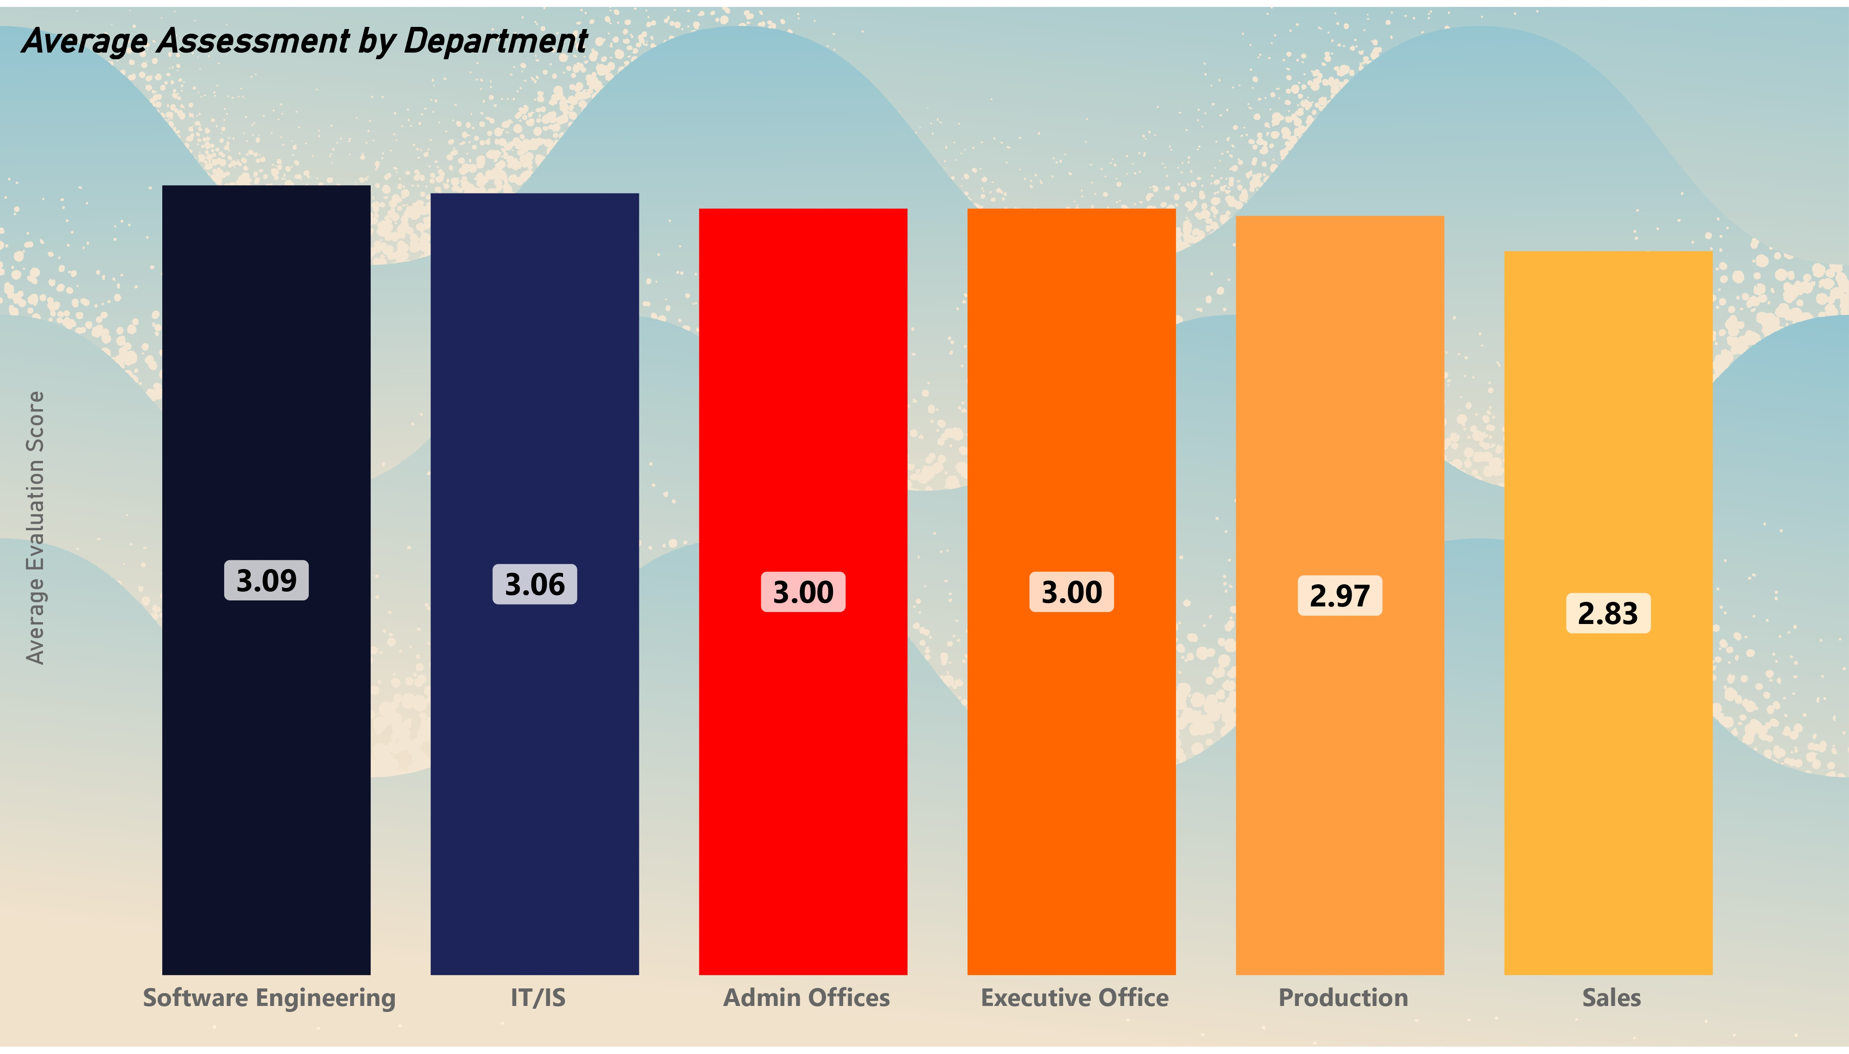
Employee Distribution by Department & Position
Observations and conclusions
" Production" sector is characterized by a concentration of workers in technical positions such as "Production Technician I and II", while the "Sales" sector includes administrative roles such as "Area Sales Manager".
This refers to the sectors' focus on specific types of jobs, with the potential to improve job diversity
-It appears that the software engineering department is less complex.
is clear that the Information Technology and Systems Department is equipped with several specializations, as it possesses most of the institution’s specializations.

Slide 13
Employee Distribution by Department & Position

Slide 14
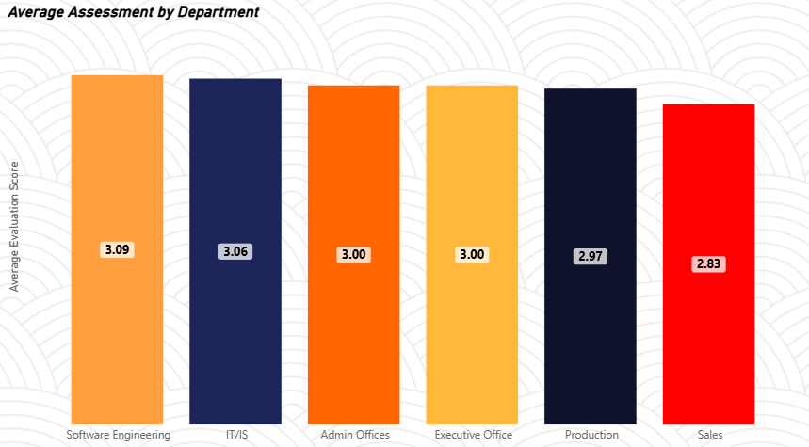
Explanation of the graph and its content
The bar chart shows the average overall employee rating in each sector.

Slide 15
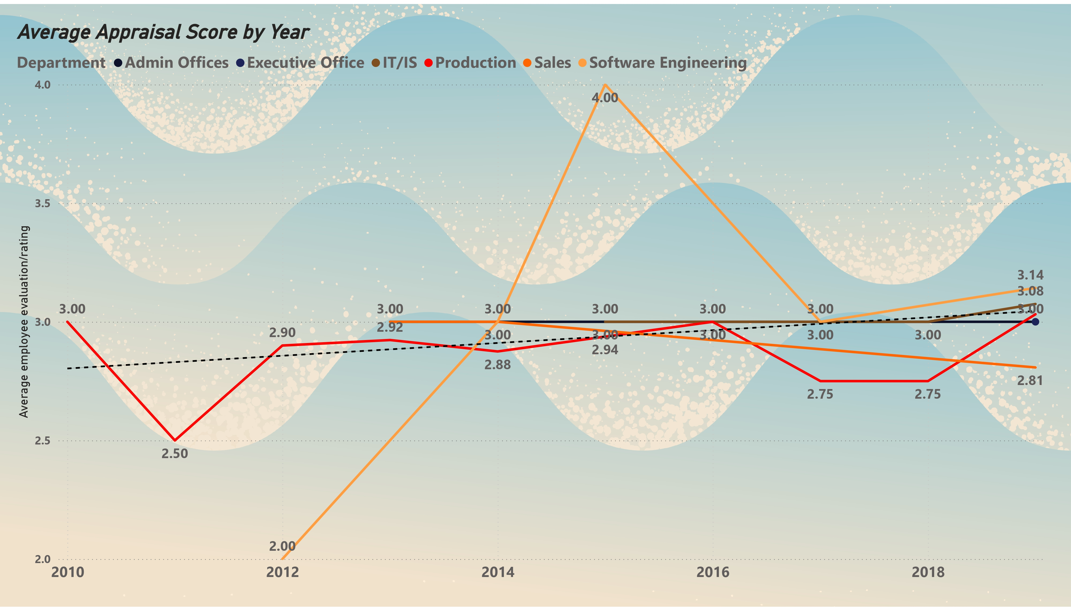
Observations and conclusions
It’s clear that the average evaluation for all sectors is very close and is on average.
The highest average performance rating is observed in the “Managers” sector (3.09), while the lowest rating is observed in the “Production” sector (2.83).
This reflects a performance gap between different sectors, perhaps due to the nature of jobs or management.

Slide 17
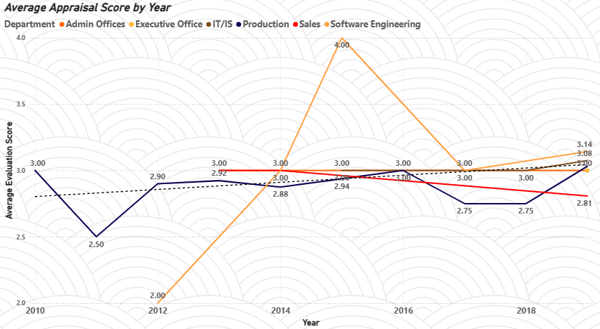
Explanation of the graph and its content
The line chart shows the average performance rating of each sector according to the years in which the rating was taken.

Slide 18
Observations and conclusions
It appears that the production department was the first to receive the 2010 evaluation, with its fluctuation in the average evaluation.
It appears that the evaluation of the software engineering department’s recruitment started in early 2012 with a strong start to the evaluation until 2015, when it declined to an average evaluation.
-It appears that the sales department has been declining in rating since its inception.
We note that the remaining specializations were launched after 2014 and are balanced on average evaluation.

Slide 19
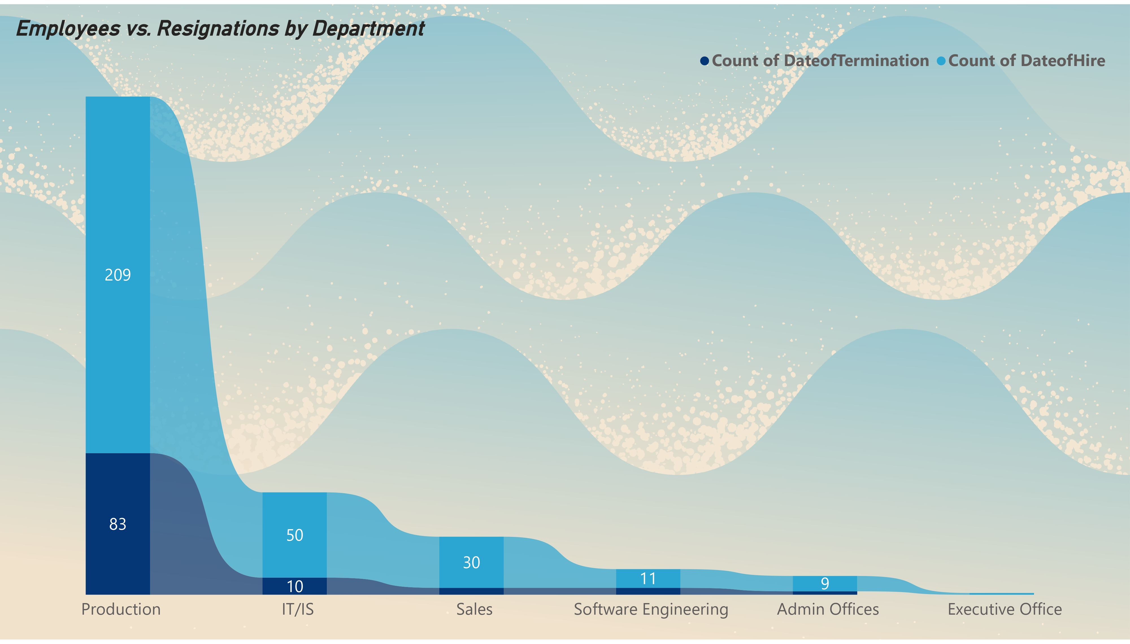
311 Total workforce/historical employees
207 Current employees
Observations and conclusions
-It appears that the sales department has been declining in rating since its inception.
We note that the remaining specializations were launched after 2014 and are balanced on average evaluation.
It appears that the production department was the first to receive the 2010 evaluation, with its fluctuation in the average evaluation.
It appears that the evaluation of the software engineering department’s recruitment started in early 2012 with a strong start to the evaluation until 2015, when it declined to an average evaluation.

Slide 20

311 Total workforce/historical employees
207 Current employees

Slide 21
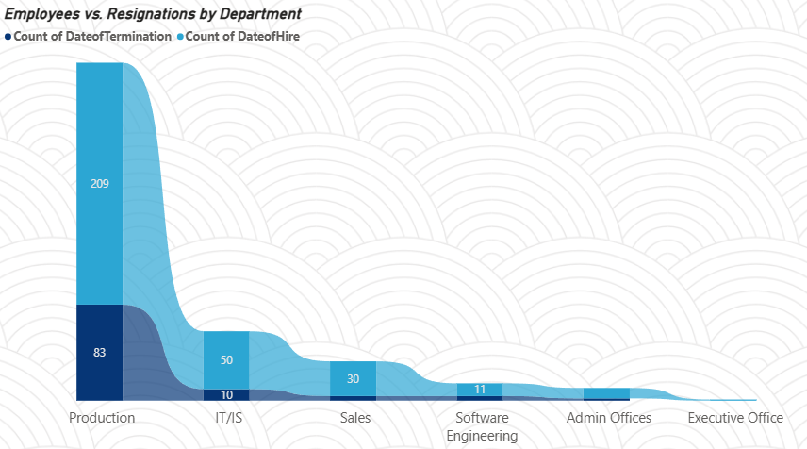
311 Total workforce/historical employees
Explanation of the graph and its content
207 Current employees
The area chart shows the number of hires versus the number of departures in each sector.

Slide 22
Observations and conclusions
- Indicating the presence of major challenges in this sector, both in employee retention and working conditions.
The IT department has the second highest number of hires, with a total of 50 employees.
311 Total workforce/historical employees
-The production department has the highest number of appointments.
The production department also had the highest number of terminations, with a total of 83, while other departments had lower termination rates.
207 Current employees

Slide 23
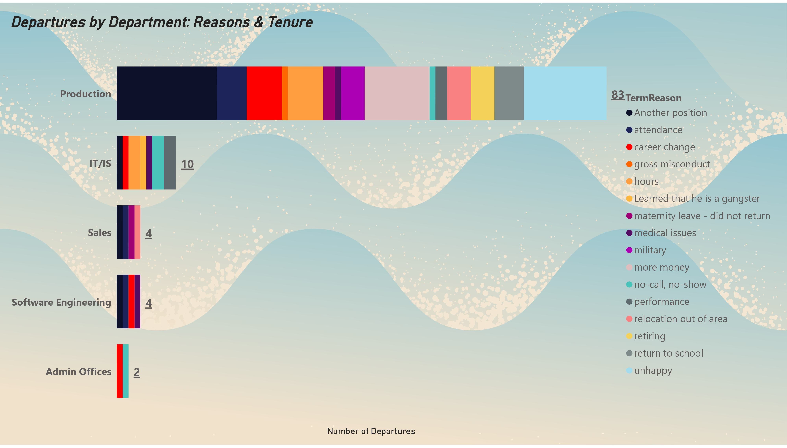
Observations and conclusions
- Indicating the presence of major challenges in this sector, both in employee retention and working conditions.
The IT department has the second highest number of hires, with a total of 50 employees.
311 Total workforce/historical employees
207 Current employees
-The production department has the highest number of appointments.
The production department also had the highest number of terminations, with a total of 83, while other departments had lower termination rates.

Slide 24
311 Total workforce/historical employees
207 Current employees

Slide 25
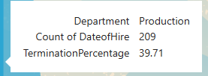
311 Total workforce/historical employees
207 Current employees

Slide 26
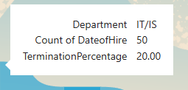

Slide 27
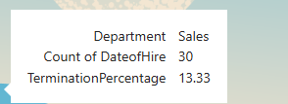

Slide 28
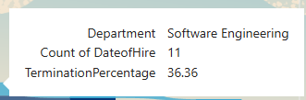

Slide 29
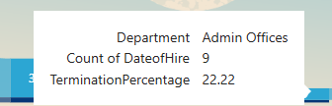

Slide 30
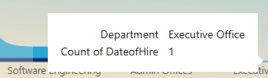

Slide 32
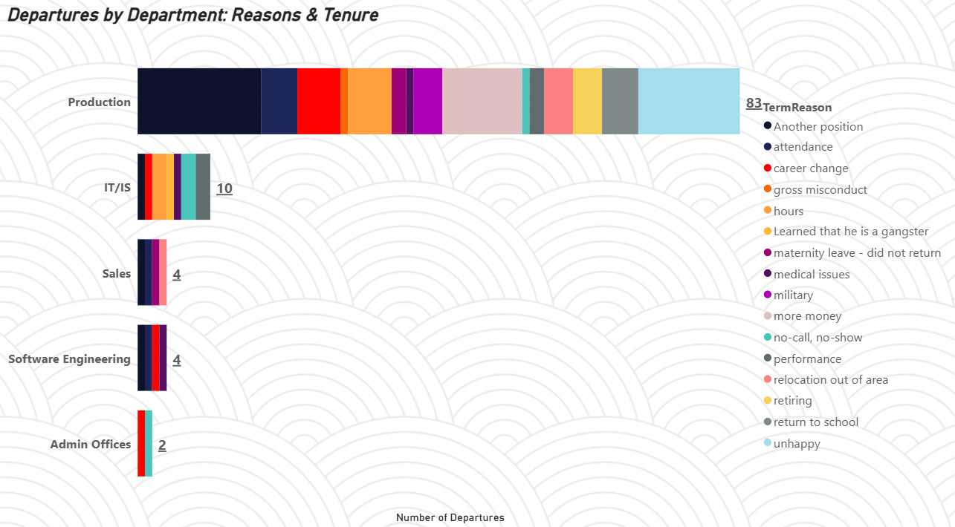
Explanation of the graph and its content
The stacked bar chart shows the number of employees leaving the organization, broken down by sector, then the reason for leaving, with the average teamwork rating for each reason.

Slide 33
Observations and conclusions
Information Technology and Systems is the second center
We notice that sales and software engineering are equal in leaving, with the supervisors' offices being the last.
We find that supervisors are the least in evaluating teamwork.
It appears that the production department has the most employees leaving and the most reasons for leaving.
-It appears that the director of the institution has never been changed.

Slide 34
Observations and conclusions
Information Technology and Systems is the second center
We notice that sales and software engineering are equal in leaving, with the supervisors' offices being the last.
We find that supervisors are the least in evaluating teamwork.
It appears that the production department has the most employees leaving and the most reasons for leaving.
-It appears that the director of the institution has never been changed.

Slide 35






Study summary
بشكل عام، قدمت دراسة الحالة رؤى قيمة وتوصيات قابلة للتنفيذ، والتي يمكن أن تساعد الشركة في تحقيق أهدافها والنجاح في السوق
It is clear that the company is facing the following:
Production sector :
It faces significant challenges in terms of the number of employee departures and employee performance, which requires intervention to improve working conditions and productivity .
بناءً على النتائج، يوصى بأن تفكر الشركة في تحسين ظروف العمل لعمال قسم الانتاج وتقديم برامج الحوافز لزيادة الأداء ورضاهم إعادة توزيع المهام والابتكار في الأدوار ثم حل مشكلة تقييم قسم البيع ثم تقليل الضغط على العاملين بشكل عام

Slide 36
Study summary
The gap between sectors :
There is a discrepancy in performance between different sectors, with “managers” performing better than “production” performing less .
Employee retention :
High turnover rates in some sectors may indicate weak employee retention strategies, especially in production .

Slide 37




Study summary
Overall, the case study provided valuable insights and actionable recommendations, which can help the company achieve its goals and succeed in the market.
Based on the results, it is recommended that the company consider improving working conditions for production department workers and introducing incentive programs. To increase performance and satisfaction, redistribute tasks and innovate roles , then solve the problem of evaluating the sales department and reduce pressure on employees in general.

Slide 38

Thank you all

